Slide 1

WELCOME TO OPEN HOUSE

Slide 2

ARRIVAL/DISMISSAL PROCEDURES
School Hours
7:45 a.m. Doors open for Cafeteria (PLEASE DO NOT BRING STUDENTS TO SCHOOL BEFORE 7:45 A.M.)
7:45 a.m. Breakfast line opens
8:00 a.m. Doors open for school
8:05 a.m. Breakfast line closed
8:15 a.m. School Begins
8:16 a.m. STUDENTS ARE LATE AND MARKED TARDY
3:05 p.m. Dismissal of Day Care/Bus Rider Students
3:10 p.m. Dismissal of After School Care Students
3:15 p.m. Dismissal of Walkers and Car Rider Students
PLEASE ALWAYS USE THE WALKWAY AND CROSS WITH THE CROSSING GUARD FOR SAFETY!!!

Slide 3


SIGN-IN/SIGN OUT
All parents must sign-in in the main office, show ID, and obtain a visitor’s badge immediately upon entering the building
Parents may sign-in before 8:15 a.m. each morning to walk students to class. Learning starts immediately at 8:15 a.m. Therefore, parents are not allowed to walk students to class after 8:15 A.M. If parents need to speak with the teacher, please schedule an appointment through the office or email your child’s teacher.

Slide 4

EARLY CHECK-OUT
PLEASE REMEMBER THAT EARLY CHECK OUT STOPS AT 2:30 P.M. STUDENTS WILL NOT BE RELEASED AFTER 2:30 P.M.

Slide 5
ATTENDANCE
CHOICE TRANSFER REQUIREMENTS
OPTIONAL TRANSFER REQUIREMENTS
Accumulation of any combination of 15 or more absences from school or class, tardies to school or class, or early dismissals from school or class (grades 1-5).
Behavior
Satisfactory/ meeting standards in conduct or work habits (grades 1-5).
B or above in final reading or math grades (grade 1-5).
Probations will not be granted two years in a row.
The student has accumulated any combination of 10 or more unexcused absences from school or class, tardies to school or class, or early dismissal from school or class.
The student has a combination of: o 3 Office referrals, In-school Suspensions, or Out-of-School Suspensions, 2 (or more) suspensions of 4-10 days for any reason, any long term Out-of-School Suspension/Expulsion

Slide 6
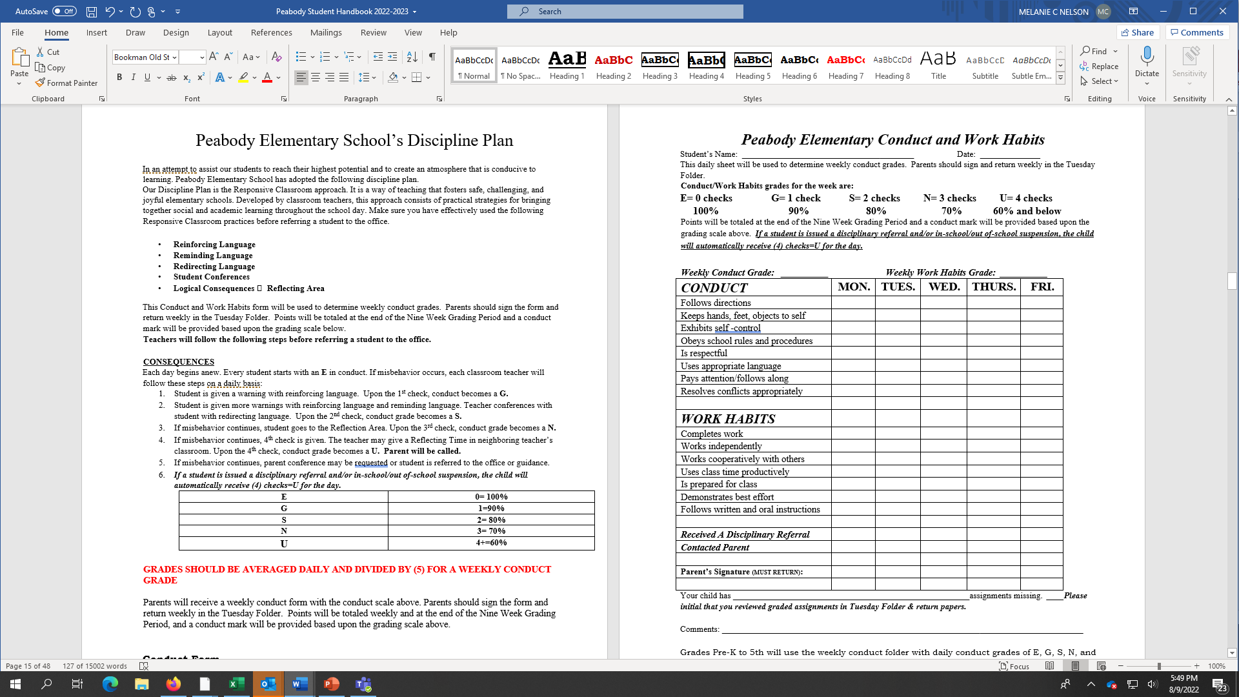
SCHOOLWIDE DISCIPLINE SYSTEM

Slide 7

Parent Concerns
If you have a concern about your child’s grades, behavior, or any situation, always schedule an appointment with the teacher to discuss the matter first.

Slide 8

Parking
Morning Parking/Arrival:
Park on side facing East bound on Young.
Park on side facing South on Tanglewood.
Side facing West on Young is only for drop-off. Cars cannot park on West side of Young during morning.
Always park alongside the curb to release students. Please DO NOT drop off/pick up students in the middle of the street.

Slide 9
Parking
Afternoon Parking/Arrival:
Park on side facing East bound on Young.
Park on side facing South on Tanglewood.
Parents are allowed to park on each side of Young during drop-off only.
Always park alongside the curb to release students. Please DO NOT drop off/pick up students in the middle of the street.

Slide 10

Parking
The School’s Parking Lot is only for staff/teachers. We ask that parents do not park or walk students through the parking lot to avoid any accidents.

Slide 11

DRESS CODE
Boys Girls
Tan, navy, black pants or shorts Tan, navy, black pants, shorts, skirts, or dresses
White, light blue, Peabody blue, navy White, light blue, Peabody blue, navy
dress shirt with collar blouse with collar
Knit, Oxford, or Turtle neck Knit, Oxford, or Turtle neck
Light jackets, sweat shirts, cardigans, sweaters, or vests may be worn; however, they must be white, light blue, Peabody blue, black, or navy- without prints or logos. Heavy coats may not be worn during the school day. No denim material may be worn. T-shirts worn underneath a shirt should be white. Yellow T-shirts or Peabody SWAG (Purchased from PTA) can be worn on Friday ONLY for Club/Spirit Day.

Slide 12


SCHOOL-WIDE INCENTIVES
FUN FRIDAY
Students who follow school-wide expectations
SOCK HOP
Meeting Goals of 70% on Benchmark Assessments each quarter

Slide 13



SCHOOL-WIDE INCENTIVES
EAGLE BUCKS FOR EXCELLENT BEHAVIOR
  Eagle Store the last Friday of each month
CAFETERIA AND SUPPORT LINKS
Movie/Snack Day
DRESS DOWN DAY ON FRIDAY
Weekly Attendance 96% or better

Slide 14



SCHOOL-WIDE INCENTIVES
AR STORE, GIFT CARDS, END OF YEAR CELEBRATION!!!
- Earn AR Points and meet AR Goals (10,000)

Slide 15
WELCOME TO OPEN HOUSE
COUNSELOR ORIENTATION
Peabody Elementary School
2023-2024
15

Slide 16

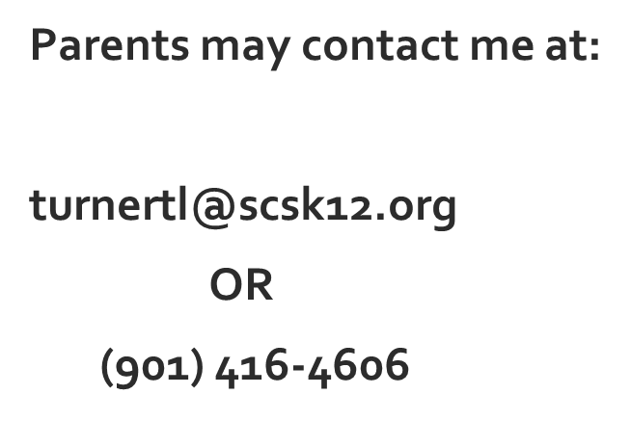
Mrs. Tamara Turner
Professional School counselor
16

Slide 17
Counselors work with...
Students
Parents
Teachers
Principals
Other school staff
Other counselors
17

Slide 18
Helper……
Counselors like to help students by making them feel comfortable and safe at school.
Counselors listen to students when they have problems at school.
18

Slide 19
Class Lessons
-SEL lessons, Conflict resolution; Bullying; Decision-making
Group Counseling (may be facilitated with school social worker)
-Social Skills; Anger Management
Individual Counseling
-Behavior Support Plans/Contracts, Transitions, Academic Counseling, Goal Setting
Organize special programs
-Career on Wheels, National No- Bullying Unity Day, Career Day, Mentoring
How do Counselors IMPACT students?
19

Slide 20
Parent Meetings
Needs Assessments will be sent home by students. Parents will have the opportunity to list topics of interest that they would like more information about. Topics may include:
Homework Tips for Parents
Building Self-esteem in Children
Academic/Behavior Referral Process
Test-taking Strategies for Parents
How to work with Your Child and ADHD
Bullying Prevention
Parent Consultation/Conferences
Referrals to outside agencies for resources
How do Counselors IMPACT parents?
20

Slide 21
Goals for Counseling
Provide a safe and nurturing learning environment where students experience success academically, socially, and emotionally.
Provide students with the necessary tools/strategies that will assist them in making good choices and becoming college and/or career ready.
21

Slide 22


MS. Virginia teague
School Social Worker
Please contact me at :
901-416-6083
teaguev@scsk12.org
Days assigned to Peabody: Wednesdays
22

Slide 23

MS. Angilene ward-clear
School behavior specialist
Please contact me at :
901-602-7045
wardcleara@scsk12.org
Days assigned to Peabody: Tuesdays & Thursdays
23

Slide 24
What If I Need Support Quickly?
MSCS SEL Hotline
(901) 416-8484
A staff member will be available to help you Monday-Friday from 9:00AM-4:30PM
The Family Wellness Centers are located at:
Cordova Middle School; Booker T. Washington High School; Manassas High School
10:00AM-8:00PM
(901) 416-1631
24

Slide 25

Peabody Elementary School
Annual Title I Parent Meeting
Melanie Nelson, Principal
August 28, 2023

Slide 26
Why are we here?
Every Student Succeeds Act (ESSA) requires that each Title I school hold an annual meeting of Title I families in order to:
inform you of your school’s participation in Title I,
explain the requirements of Title I, and
explain your rights as parents and family members to be involved.

Slide 27
What will I learn?
Notice of Title I School Status
Parents’ Right to Know
Teacher Qualifications
Opportunities for additional Parent Meetings
Availability of Parent Training
Reporting of Students’ Progress
Parent Teacher Conferences
Policies for Family Engagement
School Improvement
Parental Involvement Requirements
School/Parent Compact
Student Code of Compact

Slide 28
What is a Title I school?
Title I was passed in 1965 under the Elementary and Secondary Education Act (ESEA). It is the largest federal assistance program for our nation’s schools.
Title I schools receive extra funding (Title I dollars) from the federal government. These dollars are used to:
      identify students experiencing academic difficulties and provide assistance to help these students;
      purchase additional staff, programs, materials, and/or supplies; and
      conduct parent and family engagement meetings, trainings, events, and/or activities.

Slide 29
What can Title I funds be used for?
In general, Title I funds may be used for:
  smaller class sizes,
  additional teachers and paraprofessionals,
  additional training for school staff,
  extra time for instruction (before and/or after school programs),
  parent and family engagement activities, and/or
  a variety of supplemental teaching materials, equipment, and technology.
Notes:
Increase academic achievement
Provide direct instructional support to students
Provide professional development for teachers
Promote parent education and involvement

Slide 30
What can Title I funds be used for?
  Overall, these efforts promote the following outcomes:
  Increase academic achievement
  Provide direct instructional support to students
  Increase content knowledge and instructional strategies for teachers
  Promote parent education and involvement.

Slide 31
What are my rights?
The families and parents of Title I students have a right, by law, to:
      be involved in decisions made at both the school and district level;
      be provided with information on your child’s level of achievement on tests in reading/language arts, writing, mathematics, and science;

Slide 32
What are my rights?
The families and parents of Title I students have a right, by law, to:
    request and receive information on the qualifications of your child’s teacher and paraprofessionals who are working with your child and
    request opportunities for regular meetings to formulate suggestions and to participate, as appropriate, in decisions about the education of your child. The school is required to respond to any such suggestions as soon as practicably possible.

Slide 33
What are my rights?
All parents will receive information on the following:
Their option to request a transfer if their child becomes a victim of a violent crime
Their right to public school choice and supplemental services if their child’s school is identified for school improvement
Their right to timely notification that their child has been taught for four or more consecutive weeks by a teacher who is not highly qualified
Their child’s level of achievement in each of the State academic assessments

Slide 34
Additional Information
Qualified Teachers – classroom teachers are licensed in the areas in which they are teaching.
Additional Parent Meetings and Parent Trainings will take place later this year. Information will be sent home in the Monday email from Mrs. Nelson and teacher newsletters.
School Data – parents will be notified of school data and student specific data from 2022-23 when it is available

Slide 35
What tests will my child be taking?
Students will take state mandated and district formative assessments this year. The data is used to see which students are on track and/or students needing further testing.
2022-23 Diagnostic Assessment (August 14 – September 1, 2023): Will assess students on the previous grade level standards
District Common Assessment #1 (September 18 – October 5, 2023): Will assess Quarter 1 standards
District Common Assessment #2 (February 27-March 22, 2023): Will assess Quarter 2 & Quarter 3 standards
The required proficiency level of students will go home in Tuesday folders when it is released from the state.
Notes:
2022-23 Diagnostic Assessment
Will assess students on the previous grade level standards
Assessment window (August 14 – September 1, 2023)
District Common Assessment #1
Will assess Quarter 1 standards
Assessment window (September 18 – October 5, 2023 )
District Common Assessment #2
Will assess Quarter 2 & Quarter 3 standards
Assessment window (February 27-March 22, 2023)

Slide 36
Additional Assessments
Assessments are used to help teachers determine if a student is understanding the content presented in the classroom.
In addition to state assessments, we use the following assessments for our students:
  Common assessments in all core subjects
  K-5 Reading and Math benchmark tests (iReady and FastBridge)
  Progress Monitoring weekly and biweekly for identified students.

Slide 37
Reporting Student Progress
Daily Reports
Weekly Reports
Progress Reports (every 4 ½ weeks) – Sept. 6th
Report Cards (every 9 weeks)
Parent/Teacher Conferences – can be scheduled during their planning period by calling the office
  District Parent/Teacher Conference
    Thursday, Sept. 7th 4 p.m. – 7 p.m.
Telephone Conferences

Slide 38
How can I be involved?
Parents will become involved in the educational process by:
Regularly attending school events
Serving on the Site-based Leadership Council
Serving on the School Improvement Committee
Using talent and resources to enhance the instructional program

Slide 39
How can I be involved?
Parents can be involved by joining school decision-making committees:
School/Parent Compact: An agreement that identifies the responsibilities of the school, the parent, and the student to ensure that all students are successful in all that they do.
Family Engagement Plan: A written plan jointly developed with parents and teachers and staff that outlines expectations for parent and community involvement.
Notes:
Our teachers work hard to ensure your children are successful. However, we need your assistance and support. In our school parent compacts………
Developed in collaboration among parents, teachers and students.
Updated periodically.
Distributed with site Title I Parent Involvement Policy.
Compact- We need you assistance in helping to develop agreement. It will be reviewed throughout the year in parent conferences and meetings.

Slide 40
What is the SIP?
The SIP is the School Improvement Plan. It includes:
      the identification of the school planning team and how they will be engaged in the planning process;
      a needs assessment and summary of academic and non-academic data;
      prioritized goals, strategies, and action steps to help address the academic and non-academic needs of students;
      teacher and staff professional development needs; and
      budgets and the coordination of resources.
The school includes family representatives on our school planning team.

Slide 41
How is parent and family engagement funded?
Any district with a Title I allocation exceeding $500,000 is required by law to set aside 1% of it’s Title I allocation for parent and family engagement.
Of that 1%, 10% may be reserved at the district for system-wide initiatives related to parent and family engagement. The remaining 90% must be allocated to all Title I schools in the district.
You, as Title I parents and family members, have the right to be involved in how this money is spent.

Slide 42
What is a Parent and Family Engagement Policy?
These plans address how the district and school will implement the parent and family engagement requirements of ESSA. Components should include:
      how parents and families can be involved in decision-making and activities;
      how parent and family engagement funds are being used;
      how information and training will be provided to families; and
      how the school will build capacity in families and staff for strong parent and family engagement.
You, as a Title I parent or family member, have the right to be involved in the development of these plans.

Slide 43
What is a School-Parent Compact?
A school-parent compact is a written commitment that outlines how the entire school community – teachers, families, and students will share the responsibility for improved academic achievement.
The compact must describe how the school will:
      provide high-quality curriculum and instruction;
      hold parent-teacher conferences, annually in elementary schools;
      provide parents with reports on their child’s progress;
      provide parents reasonable access to staff.
      provide parents opportunities to volunteer; and
      ensure regular two-way meaningful communication between family members and staff, to the extent practicable, in a language family members can understand.
You, as a Title I parent or family member, have the right to be involved in the development of the compact.
The School-Parent Compact can be located in the Peabody Parent-Student Handbook.

Slide 44
How can I be involved on a daily basis?
encouraging attendance;
monitoring grades and schoolwork on an online system or portal;
reading school/classroom newsletters or websites and that contain examples of learning activities families can do with students at home;
attending family events and meetings;
observing or volunteering in classrooms; and
joining family groups and PTA.

Slide 45
Opportunities for Parent Involvement at Peabody
Watch DOGS
Parent/Teacher Conferences
Various meetings (Site-based Leadership, PTA)
Parent Workshops *
Family Events (Curriculum Nights)
Awards Assemblies
Invitations to classroom activities
Field Day
Assessment Proctor
International Festival
Room Parent

Slide 46
What can I do to support my child?
Share a love of learning
Read to your child
Ask your child to read to you
Limit TV time
Take advantage of the public library and the school media center
Show interest in your child’s school day
Ask questions
Ask to see homework
Praise their efforts
Encourage good study habits-set aside a time and a quiet place for them to study and do homework

Slide 47
Get to know your school –
Communicate with Teachers
Tuesday Folders
Attend school events
Visit the classroom
Volunteer at the school
Join parent organizations
Keep teachers informed
Attend special parent trainings through Title I
Attend parent-teacher conferences
Be prepared for the meetings
Consider whether you have met your responsibilities as stated in the parent-school compact
List your questions before the meeting

Slide 48
District/School Code of Conduct
  This information is found in the Student-Parent Handbook
  All school consequences for discipline infractions follow the district code of conduct.

Slide 49
Who can I contact for help?
For general questions, call the front office at:
901-416-4606 or email the faculty or staff directly.
The Peabody Admin staff is here to help you:
  Melanie Nelson, Principal
  Kevin Morris, Assistant Principal
  Rebecca Hobson, Professional Learning Community Coach
  Shonte Hill, Optional Coordinator
  Tamara Turner, School Counselor

Slide 50
WE JUST WANT TO SAY…
THANK YOU!
Notes:
Be sure to thank families for their time.
Move this slide to the end if additional slides are added.

